Slide 1


zkLLM: Zero-Knowledge Proofs for Large Language Models
Group 3
Member
110590005 蕭耕宏, 112C53035 王煥昇, 113C53006 吳仲霖,
113598043 張育丞, 113598088 李以謙

Slide 2
Introduction
AI Legitimacy and Concerns
Surge in AI, especially LLMs, has led to legal and ethical challenges (e.g., lawsuits, executive orders).
Verifying LLM-generated outputs is crucial for addressing concerns like copyrighted material misuse and harmful content.
Challenges in LLM Auditing
LLM parameters are protected as intellectual property, making direct examination impossible.
Existing ZKP frameworks are not optimized for LLMs, which require:
Handling non-arithmetic operations (e.g., GELU, SwiGLU activation functions).
Managing memory and computational overhead.
Necessity of Zero-Knowledge Proofs
ZKPs ensure verifiable computations without exposing model details.
Traditional ZKP methods struggle with LLM-specific challenges like the attention mechanism and frequent use of Softmax functions.
BY 張育丞

Slide 3
Proposed Solution: zkLLM
zkLLM is a Zero-Knowledge Proof scheme tailored specifically for LLMs, addressing the challenges of scalability, efficiency, and security.
Core Innovations
tlookup:
A unique ZKP protocol for universal non-arithmetic operations in deep learning.
No asymptotic overhead in memory or runtime.
High parallelization capability, leveraging GPUs.
BY 張育丞

Slide 4
Proposed Solution: zkLLM
zkAttn:
A ZKP protocol for attention mechanisms in LLMs.
Enhances tlookup to address attention mechanism challenges.
Avoids bit-decompositions and polynomial approximations.
Mitigates proof overhead while maintaining accuracy.
BY 張育丞

Slide 5
Proposed Solution: zkLLM
Implementation Highlights
Efficient CUDA implementation.
Suitable for LLMs with up to 13 billion parameters.
Performance:
Proving times: 1-15 minutes.
Proof size: <200 kB.
Verification time: 1-3 seconds.
BY 張育丞

Slide 6
Key Technical Contributions
Handling Non-Arithmetic Operations
Addresses challenges with activation functions like GELU and SwiGLU.
Utilizes lookup arguments for efficient verification.
Refined Attention Mechanism Verification
Tackles challenges of multivariate Softmax functions in LLMs.
Tailored approach for layers where Softmax is extensively used.
Parallel Computing Optimization:
High-level parallelization using GPU resources to minimize runtime and memory usage.
BY 張育丞

Slide 7
Significance
zkLLM is the first ZKP protocol specifically designed for LLMs.
It balances accuracy, efficiency, and security, addressing the unique demands of modern LLMs.
Facilitates trust and transparency in AI applications, especially in legally sensitive scenarios.
BY 張育丞

Slide 8
Technical Overview - Key Requirements
Parallelization
Full utilization of CUDA for GPU acceleration.
Enables efficient handling of large-scale proofs.
Non-Arithmetic Operations
Addressing operations like GELU and SwiGLU.
Adapting existing ZKP methods for modern LLM structures.
BY 張育丞

Slide 9
Core Innovations
Tlookup
Verifiable non-arithmetic tensor operations.
Ensures efficient memory usage and supports high parallelization.
zkAttn
Tailored for attention mechanisms.
Reduces overhead while maintaining accuracy.
Handles multivariate Softmax operations efficiently.
BY 張育丞

Slide 10
Implementation Features
CUDA Optimization
Fully parallelized implementation.
Scalable to LLMs with up to 13 billion parameters.
Compact Proofs
Proof size: <200 kB.
Proving time: 1-15 minutes.
Verification time: 1-3 seconds.
BY 張育丞

Slide 11
Applications
Key Benefits
Verifies LLM inference without exposing model details.
Supports legal and compliance use cases, such as verifying AI-generated outputs for regulatory requirements.
BY 張育丞

Slide 12
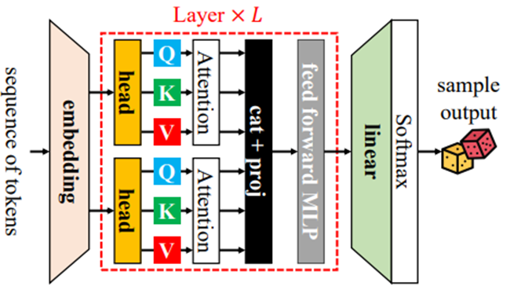
Large language models, transformers,
and the attention mechanism
Exceptional performance in general-purpose language understanding and generation tasks.
BY 吳仲霖

Slide 13
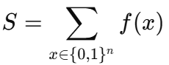
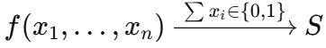
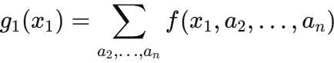
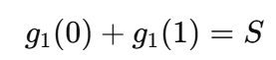
What is the Sum Check Protocol?
An interactive proof protocol used to verify the correctness of summation for multivariate polynomials.
The verifier wants to know:
Whether S equals the value S* claimed by the prover, without having to traverse all input combinations personally.
The verifier randomly selects r1 and requests the prover to provide the correct value of g1(r1). If correct, the problem is transformed into verifying the summation properties of g1(r1).
The prover claims:
BY 吳仲霖

Slide 14
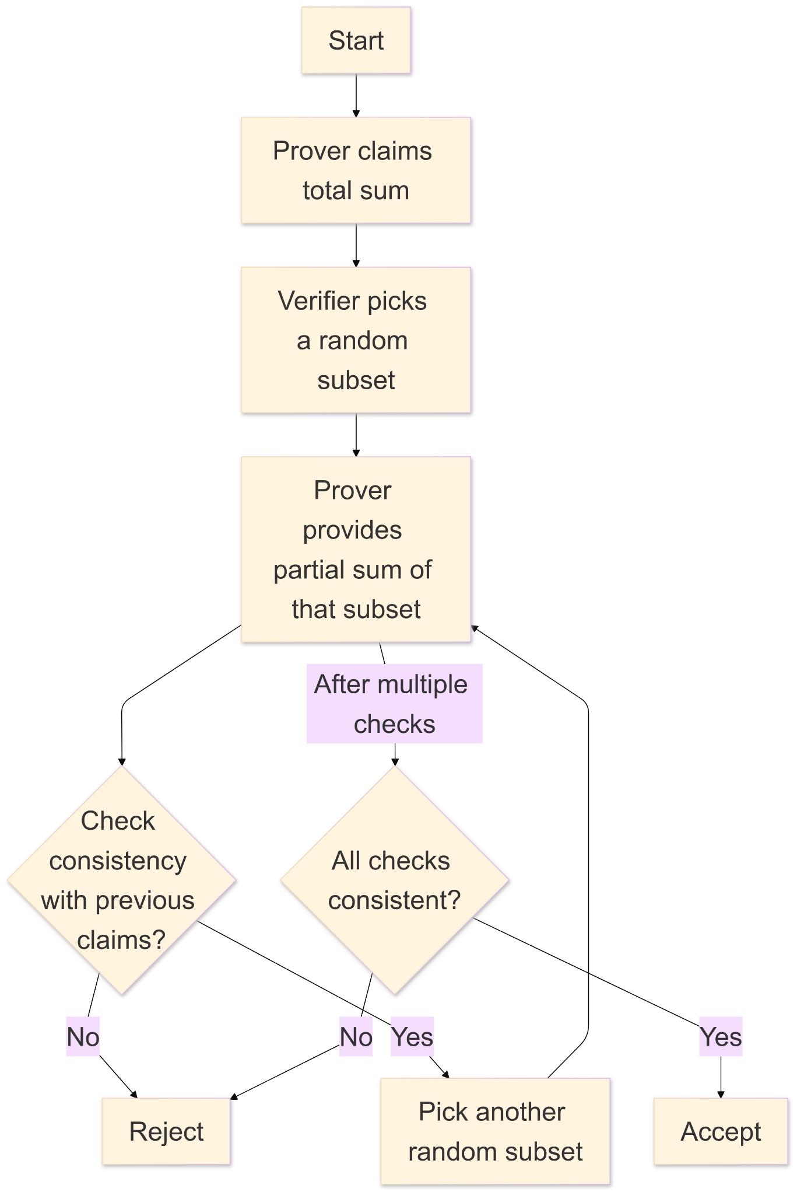
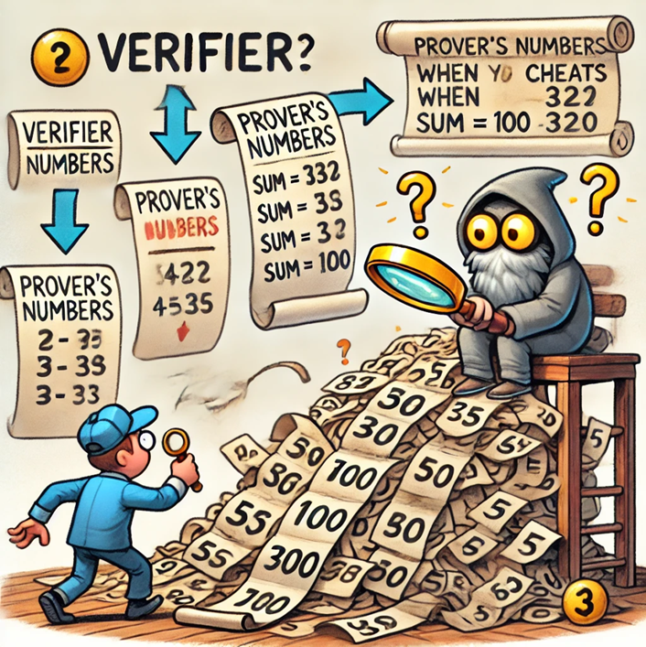
SumCheck flowchart
BY 吳仲霖

Slide 15
SumCheck Features
Interactive Process
Efficient verification
Low error probability
Reduces the success rate of the prover's deception through the verifier's random queries.
Eliminates the need to compute the total sum of all inputs.
It is difficult for the prover to pass multiple random checks if they are deceitful.
BY 吳仲霖

Slide 16
What is the Polynomial Commitment?
Definition: A cryptographic commitment mechanism for polynomials.
Committee‘s Role:
Commits to a specific polynomial f(x).
Opens the commitment later to prove its validity.
Verifier's Role:
Confirms the committed polynomial without seeing the full polynomial.
Queries any point xxx and verifies the correctness of f(x) at that point with a proof.
Key Feature: Efficient and secure verification of polynomial values.
BY 吳仲霖

Slide 17
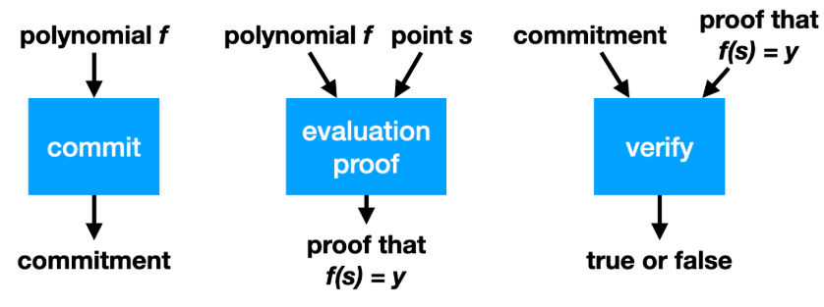
Polynomial Commitment flowchart
BY 吳仲霖

Slide 18
Polynomial Commitment Features
Hiding & Binding
Compact Proof
Once the polynomial is committed, it cannot be easily altered; the full details of the polynomial are not exposed.
The proof is small in size, with short verification times.
BY 吳仲霖

Slide 19
Comparison Table
Aspect | Polynomial Commitment | SumCheck Protocol
Core Function | Commits to a specific polynomial and efficiently verifies its value at a given point. | Verifies the correctness of the sum of a multivariate polynomial over its entire domain through an interactive process.
Interactivity | Can be non-interactive or require minimal interaction. | Fundamentally a multi-round interactive proof.
Verification | Verifies the correctness of f(x) at any point x=a, ensuring f(a) is accurate. | Verifies whether equals the claimed value.
Technical Focus | Compresses polynomial information into small commitments and point-value proofs. | Uses randomness and phased checks to reduce the success rate of fraudulent proofs.
BY 吳仲霖

Slide 20
Tlookup Background Introduction
Preserves the characteristics and advantages of tensor structures.
Is compatible with existing deep learning computation frameworks, making it easier to implement Zero-Knowledge Proofs in mainstream frameworks.
Input Layer
Dense Layer + ReLU
Attention Mechanism
Output Layer
Softmax Layer
Dense Layer + ReLU
BY 吳仲霖

Slide 21
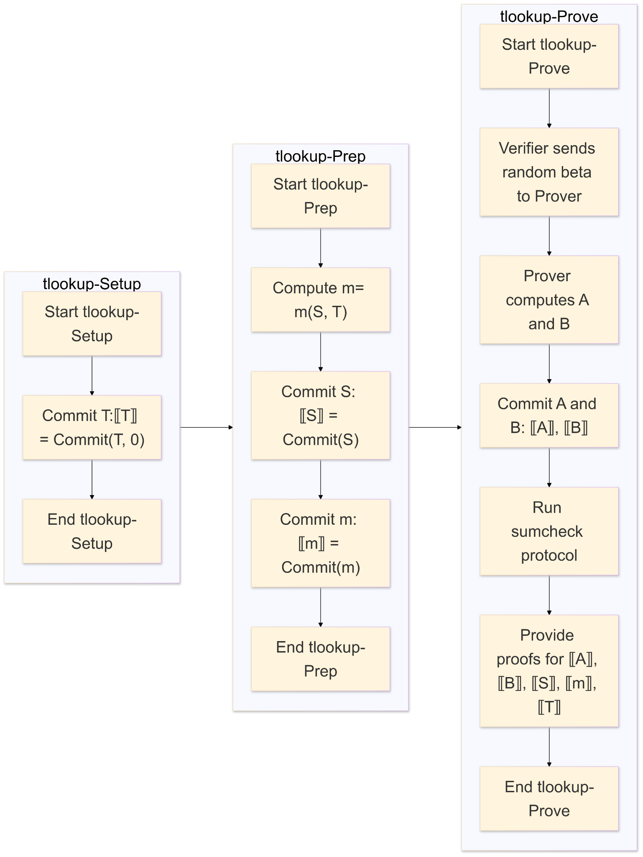
The flowchart of Tlookup
Create a table T containing all tensors.
Ensure that the tensor S owned by the provider must exist in the table.
Transform the computation of non-arithmetic operations into table lookups.
BY 吳仲霖

Slide 22
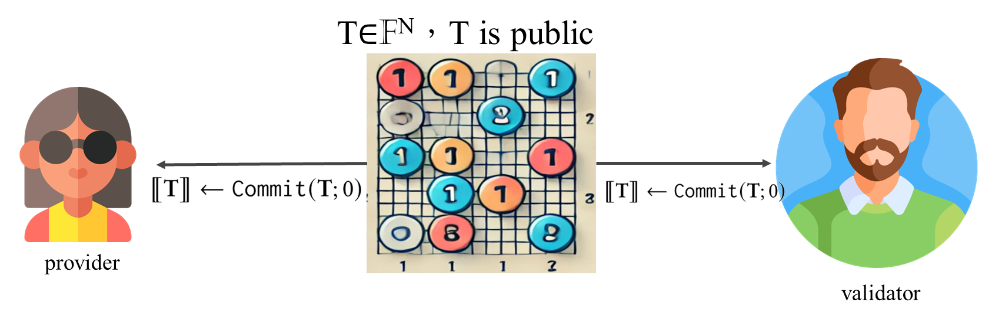
1st tlookup-Setup
𝑁, 𝐷 are both powers of 2 such that 𝑁 divides 𝐷.
BY 吳仲霖

Slide 23


I have S，S∈$F^{D}$
and S⊆T, S can’t let
validator know value
is or any information
I want to verify the
value S you say you have is
correct
BY 吳仲霖

Slide 24

2nd tlookup-Setup
input S∈ $F^{D}$，T∈ $F^{N}$
Commit(S), Commit(m)
Calculate m:m←m(S,T)
Gen Commit(S), Commit(m)
BY 吳仲霖

Slide 25
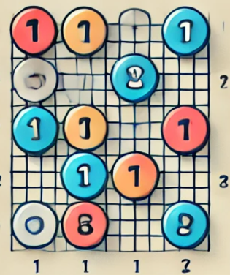
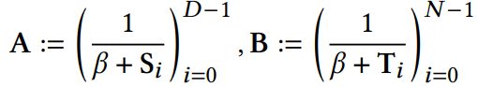
3rd tlookup-Setup
⟦S⟧, ⟦m⟧ , ⟦T⟧
Random choose β
β∼F
Commit(A),
Commit(B)
β
Calculate A, B
BY 吳仲霖

Slide 26
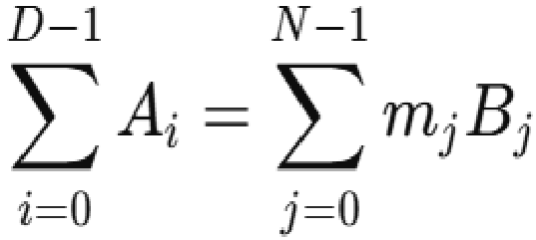
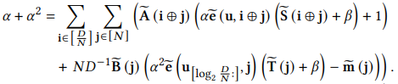
Verification Procedure
RUN
SUM-CHECK
If S⊆T
⟦A⟧ , ⟦B⟧ , ⟦S⟧ , ⟦m⟧，⟦T⟧
BY 吳仲霖

Slide 27
Final result (Repeat several times)
Now, You can trust me?
Yeah!!
BY 吳仲霖

Slide 28
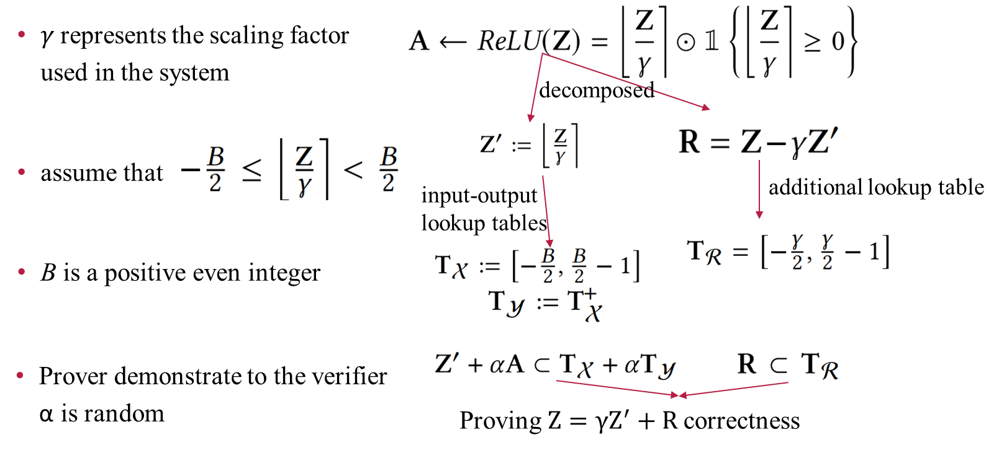
How tlookup used on Example: ReLU
BY 吳仲霖

Slide 29
Advantage
Method | Memory Overhead | Time Overhead
Traditional Method (single lookup table) | O(Bγ) | O(Bγ)
Using Two Lookup Tables | O(B+γ) | O(B+γ)
BY 吳仲霖

Slide 30
Verifiable Tensor Operations
Matrix multiplication
Activation function
Normalization
BY 李以謙

Slide 31
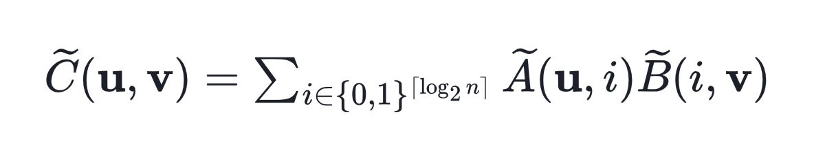
Matrix multiplications
Sumcheck Protocol
Efficiency
Avoids recalculating all elements in AB. Suitable for LLM-scale computations.
Scalability
Handles the large matrix sizes typical in LLMs.
Correctness Assurance
Ensures high confidence in AB correctness without full re-computation.
BY 李以謙

Slide 32
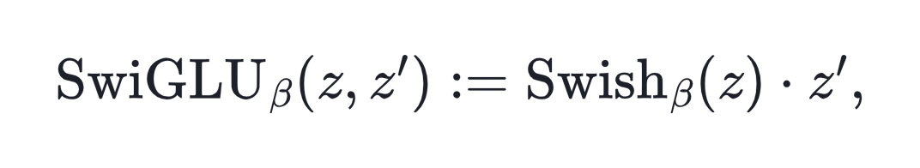
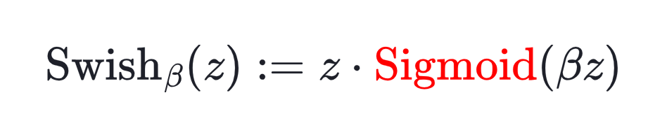
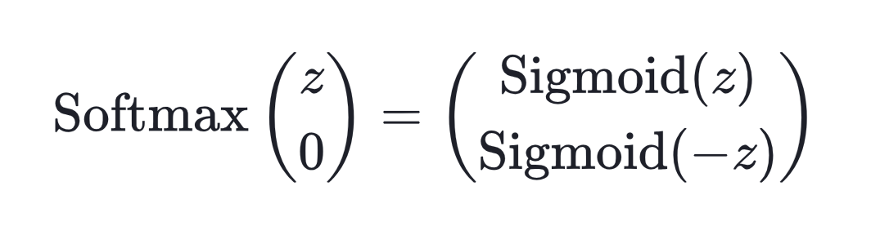
Activation function
Lower Overhead
Memory Efficiency
Better Scalability
BY 李以謙

Slide 33
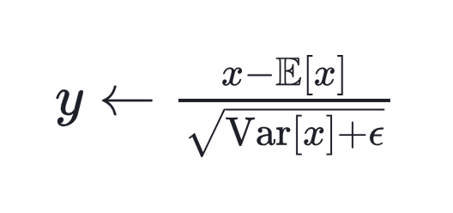
Normalization
Formula for LayerNorm
(non-linear)
tlookup steps:
Step 1. Input Scaling:
Prepares the input(x) by reducing numerical instability and optimizing memory usage.
Step 2. Quantized Compound Operation:
Computes the LayerNorm output efficiently and accurately using preprocessed inputs.
BY 李以謙

Slide 34
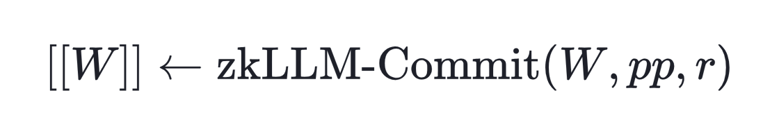
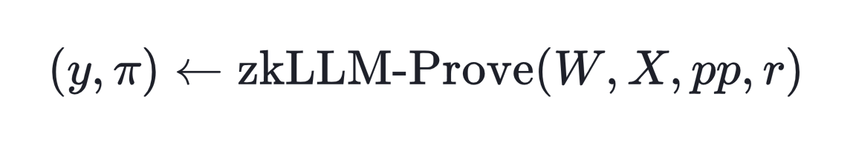
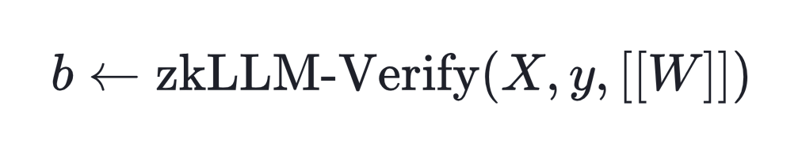
Assembly of the proofs
To improve readability, zkLLM can be simplified into three main components (omitting additional commitments caused by tLookup):
Step 1. Commitment
Step 2. Proof Generation
Step 3. Verification
BY 李以謙

Slide 35
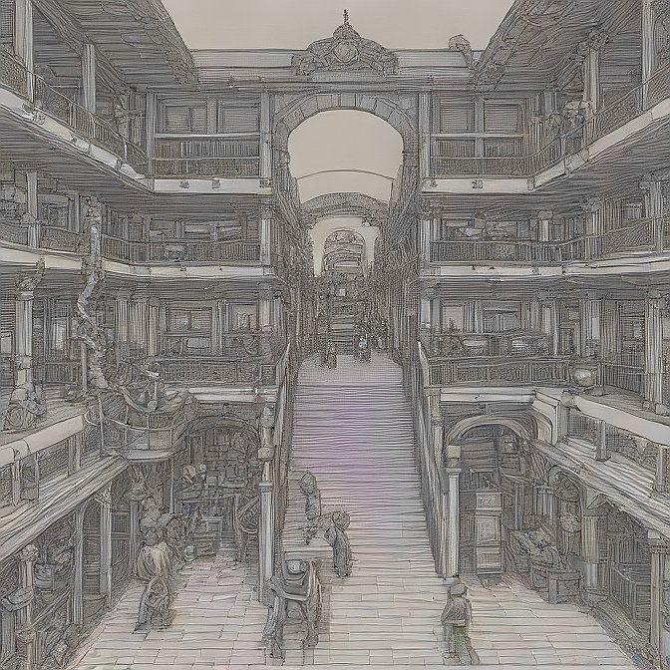

zkAttn
Dedicated ZKP for the attention mechanism in LLMS.
Issues is on Softmax function
non-arithmetic operations
Multivariate nature
BY 蕭耕宏

Slide 36
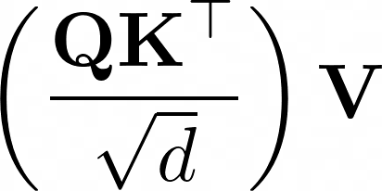
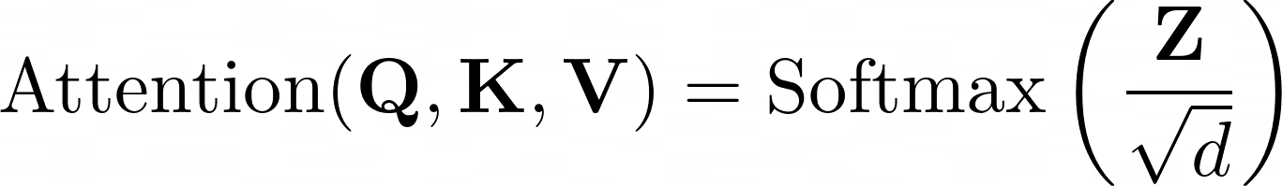
The attention mechanism
BY 蕭耕宏

Slide 37
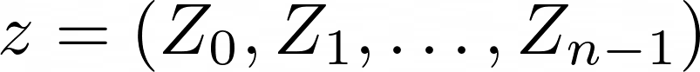
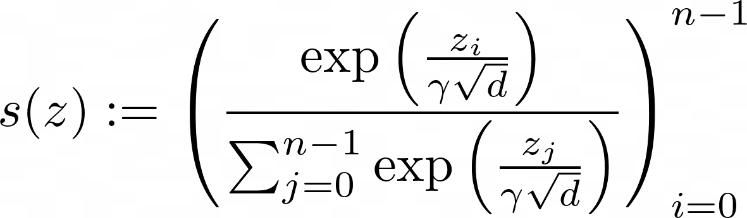
zkAttn Formulation
Devise an algorithm that computes s(z) in the real domain.
BY 蕭耕宏

Slide 38
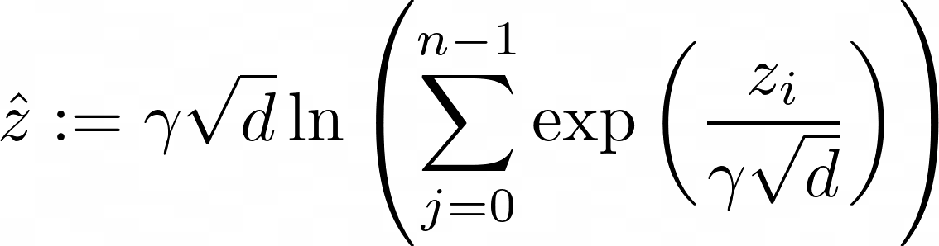
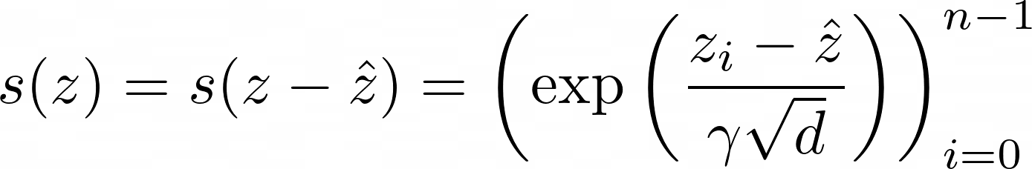
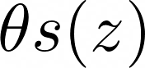
zkAttn Formulation
How to have manageable proof generation? Use the shift-invariance property of Softmax
BY 蕭耕宏

Slide 39
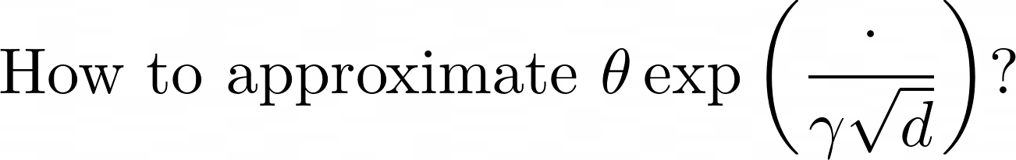
zkAttn Formulation
BY 蕭耕宏

Slide 40
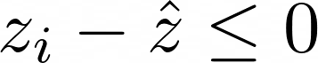
Observation
logarithm of a sum of exponentials.
BY 蕭耕宏

Slide 41
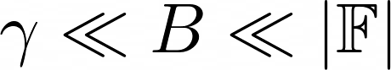
Assumption 1
Assumption 2
BY 蕭耕宏

Slide 42
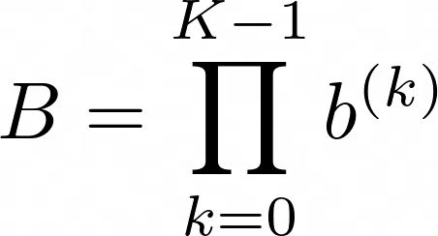
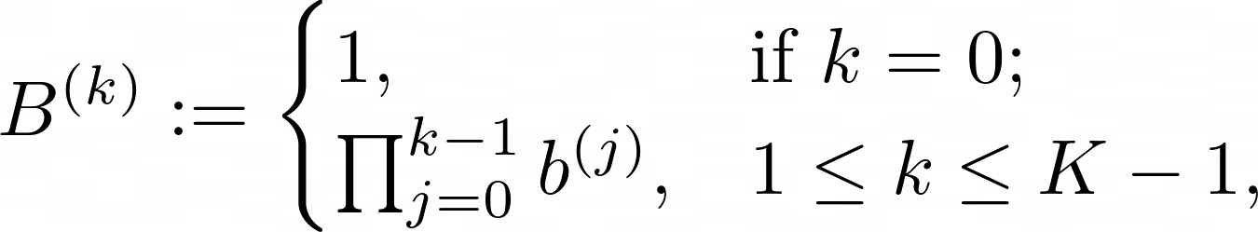
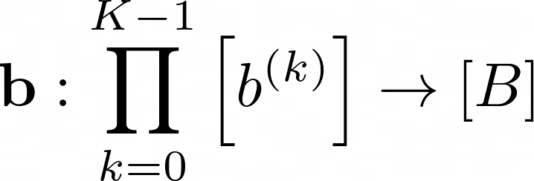
zkAttn Formulation
A bijection can be established
BY 蕭耕宏

Slide 43
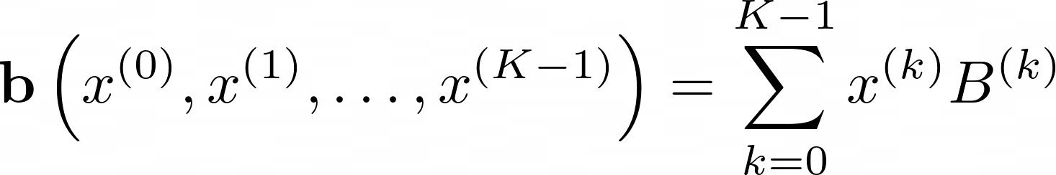
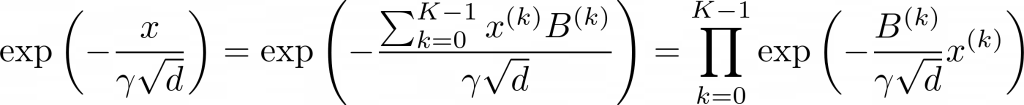
zkAttn Formulation
BY 蕭耕宏

Slide 44
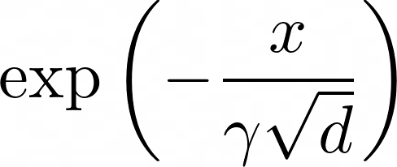
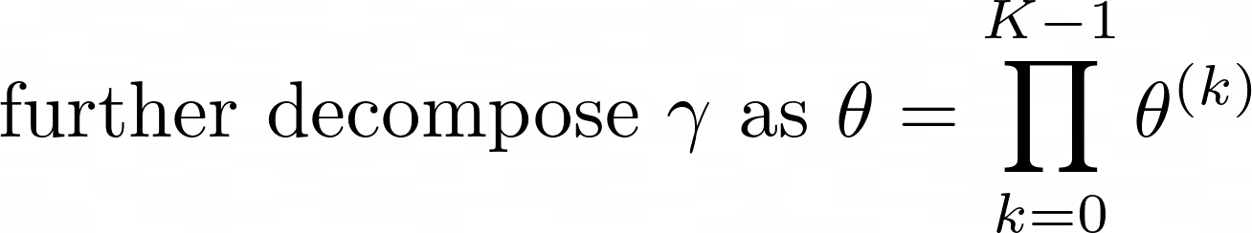
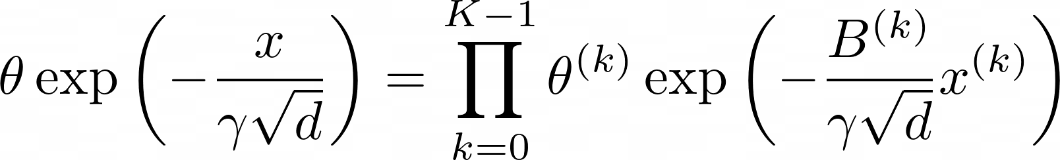
zkAttn Formulation
Taking into account the scaling factor gamma
BY 蕭耕宏

Slide 45
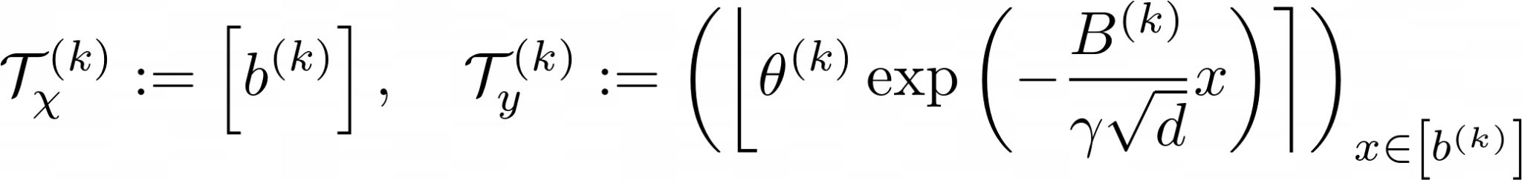
zkAttn Formulation
BY 蕭耕宏

Slide 46
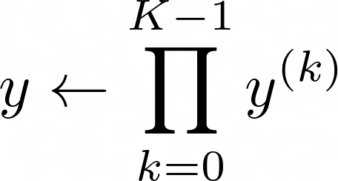
zkAttn Formulation
BY 蕭耕宏

Slide 47
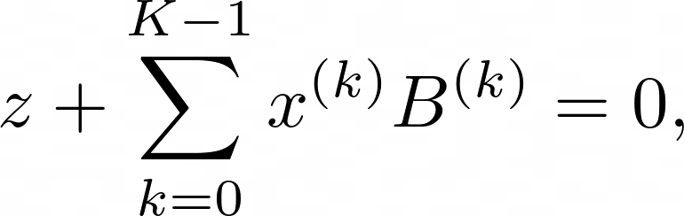
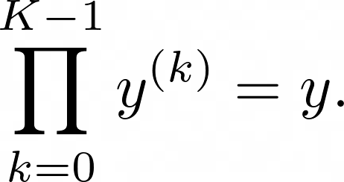
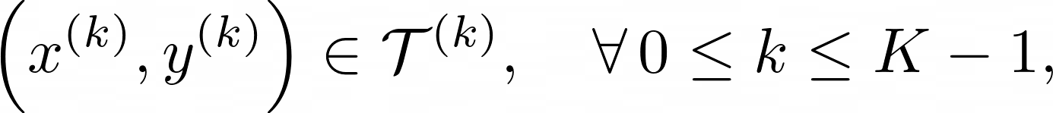
zkAttn Formulation
BY 蕭耕宏

Slide 48
Experiments
Development
zkLLM was developed using CUDA, leveraging the BLS12-381 curve from the EC-GPU package.
Sequential verifier tasks were adapted from zkCNN, utilizing the mcl package.
Model and Dataset
Tested on two open-source LLMs: OPT and LLaMa-2.
Supported up to 13 billion parameters.
Used samples from the C4 dataset, with a default sequence length of 2048.
Hardware Resources
Memory: 124.5 GB.
CPU: 12 cores of AMD EPYC 7413 (2.65 GHz, 128M L3 cache).
GPU: NVIDIA A100 SMX4 with 40 GB memory.
BY 李以謙

Slide 49
Experiments
Scaling Factor: Set to 2^16 for data and parameters.
tLookups
5 segments (K=5), each size 2^16.
Precision maintained at 2^-16.
Error Control
Tolerable L1 error: 10^-2.
Comparable to rounding errors in modern LLMs.
BY 李以謙

Slide 50
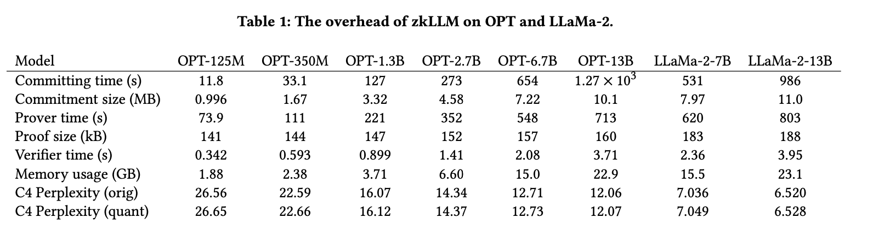
Experiments
BY 李以謙

Slide 51
Experiments
Commit Efficiency
The model commit is completed in 20 minutes, generating approximately 10MB of commitment data.
Inference Proof
The correctness proof for the inference process is generated in less than 15 minutes.
Memory Optimization: Memory consumption is controlled under 23.1GB, making it compatible with commonly used GPUs such as V100 and A100.
Perplexity Impact
On the C4 dataset, quantization increases perplexity by under 0.01 for 13B models, ensuring high accuracy.
BY 李以謙

Slide 52
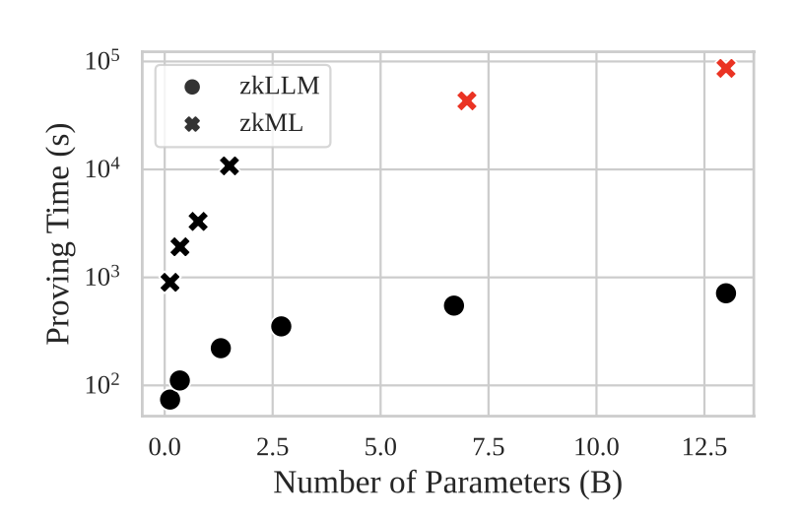
Experiments
10x larger sizes 50x speedup
BY 李以謙

Slide 53
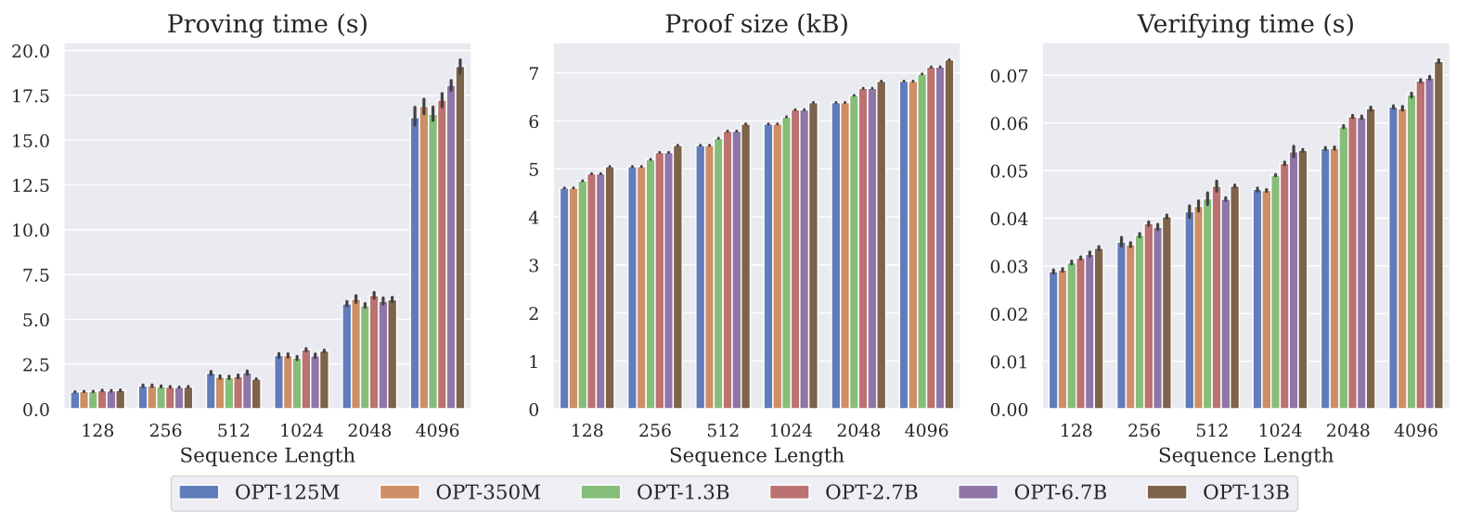
Experiments
BY 李以謙

Slide 54
Analysis
Error Analysis on zkAttn - Examine the error by zkAttn.
Security & Privacy Analysis - Facilitates the verifiable computation of lookup protocol across all non-arithmetic components.
3. Overhead Analysis - Analyze the running times, memory, and communication costs of the prover and verifier.
BY 王煥昇

Slide 55


7.1. Error Analysis on zkAttn
The errors of zkAttn are from 2 sources:
The rounding of the shifting factor
The rounding of each segment encoded in lookup tables
BY 王煥昇

Slide 56








7.1. Error Analysis on zkAttn
The Lower Bound of Input and the Factorization:
Total Numbers of Segments:
Most Significant Segments:
Lease Significant Segments:
Scaling Factor of Input, Output, Each Segment:
Dimension Parameter of the Input:
Tolerable Error in Row-wise Normalization:
BY 王煥昇

Slide 57


7.1. Error Analysis on zkAttn
BY 王煥昇

Slide 58

7.1. Error Analysis on zkAttn
BY 王煥昇

Slide 59

7.1. Error Analysis on zkAttn
BY 王煥昇

Slide 60







7.1. Error Analysis on zkAttn
Conclusion
Minimizing and can reduce error.
has no dependence on the segmentation except and
defines the tolerable error row-wise sum upon checking the normalization and it must be in
BY 王煥昇

Slide 61


7.2 Security & Privacy Analysis
pp: Public Parameter
W: Private Parameter
com: Commitment of Encryption, [W]
X: Query
A: Adversary
BY 王煥昇

Slide 62




7.3 Overhead Analysis
tlookup overhead - N = O(D), N: total size of tensor D: dimensions of the tensor
Committing + Proving Commitment + SumCheck Protocols: O(D)
Memory Requirement: O(D)
Committing: O(D^1/2)
Proving: O(logD)
SumCheck: O(logD)
BY 王煥昇

Slide 63




7.3 Overhead Analysis
2. zkAttn overhead
K: the numbers of input segment
m * n: the rows * columns of input segment
Prover Overhead:
Verifier & Communication Overhead:
Which is better than bit-decomposition method:
The Time Reduction is:
BY 王煥昇

Slide 64



7.3 Overhead Analysis
3. Overall overhead (zkLLM overhead)
Prover Overhead:
Verifier Overhead:
Communication Overhead:
Unlike univariate polynomial-based ZKP system that must be serialized, the use of sum check protocols over multilinear extensions allows highly parallelized proof generation, thereby enabling efficient proof generation.
BY 王煥昇

Slide 65
7.3 Overhead Analysis
Conclusion
zkLLM achieves significant efficiency improvements for both prover and verifier compared to traditional methods.
zkAttn reduces overhead compared to bit-decomposition, particularly in large-scale inputs, making it more practical for real-world applications like LLM inference.
The overall system is designed to exploit parallelism, repetitive structures, and batching to minimize costs, especially for large L-layer models.
BY 王煥昇

Slide 66
Conclusion
Innovative Solution
zkLLM introduces the first Zero-Knowledge Proof (ZKP) system designed specifically for Large Language Models (LLMs).
Key Contributions
tlookup: Efficiently handles non-arithmetic operations in deep learning.
zkAttn: Tailored protocol for the attention mechanism, balancing accuracy, runtime, and memory usage.
BY 張育丞

Slide 67
Conclusion
Scalability and Efficiency
Supports LLMs up to 13 billion parameters with compact proofs and fast verification.
Real-World Applications
Ensures inference authenticity while protecting intellectual property.
Facilitates compliance with AI regulations and ethical guidelines.
Takeaway: zkLLM is a groundbreaking step towards secure and transparent AI verifiability, combining computational rigor with practical efficiency.
BY 張育丞

Slide 68
Thank You
Member
110590005 蕭耕宏, 112C53035 王煥昇, 113C53006 吳仲霖,
113598043 張育丞, 113598088 李以謙

